Slide 1
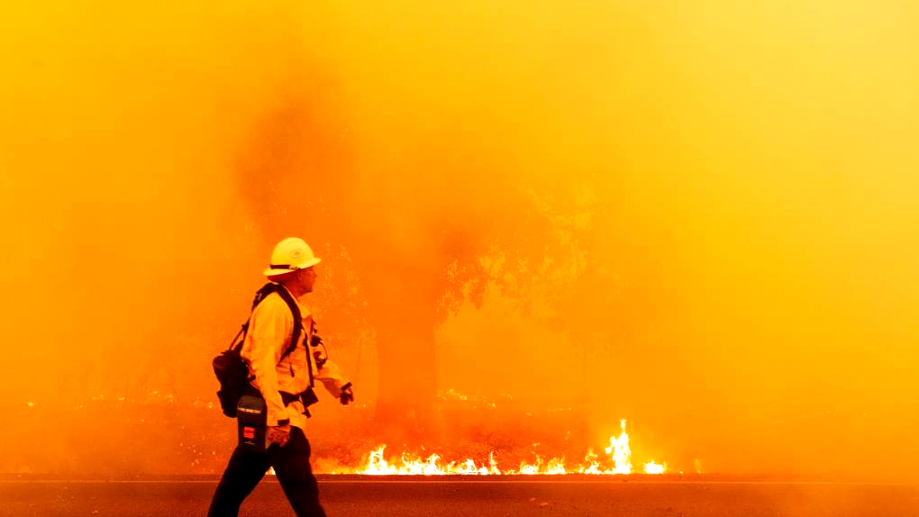



PREDICTION AND INFERENCE OF LARGE WILDFIRE BURN AREA IN THE CONTIGUOUS UNITED STATES
2023 TAMIDS Student Data Science Competition
Team – Sam’s Strikers
Shubham Jain Sambandh Bhusan Dhal
Krishna Chaitanya Gadepally
Prathik Vijaykumar
Picture Courtesy: kqed.org

Slide 2
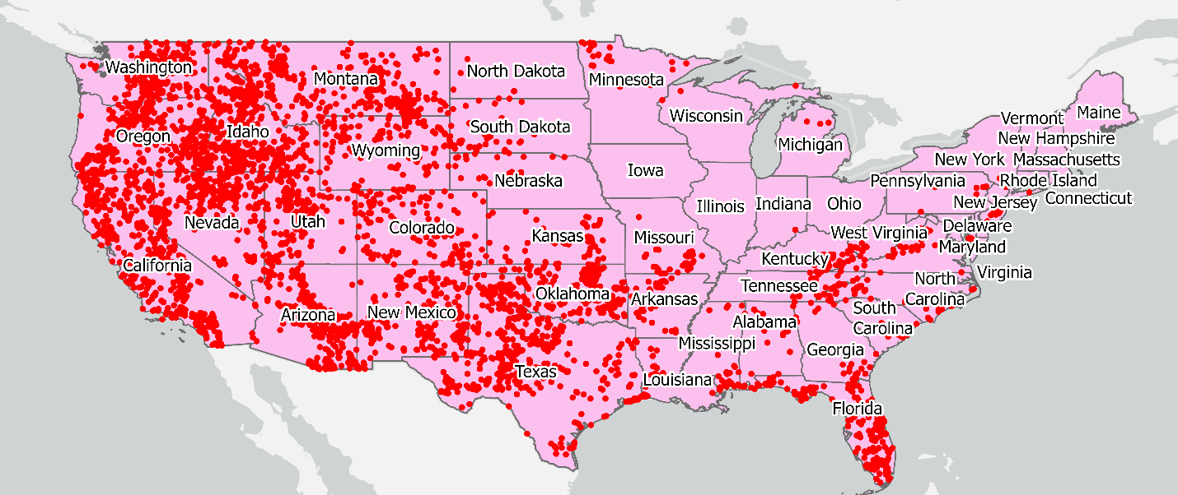
Introduction
Primary focus on two challenges: wildfire behavior prediction and effective communication of research findings
Wildfire behavior is complex, and predicting it accurately is challenging
Effective communication of research findings to end-users is critical in addressing the wildfire problem
In last decade, the US witnessed 70,000 wildfires per year, burning 7 million acres of land on average
Texas had 3,700 wildfires in 2021, burning around 200,000 acres of land
Data-driven approaches can help in predicting wildfire spread and ultimately reducing their impact
A Deep Learning approach is used to predict burn area for large wildfire occurrences based on climate forcings and geological characteristics
Map of large wildfire incidents in the contiguous US between 2011 and 2020 (4538 incidents)

Slide 3
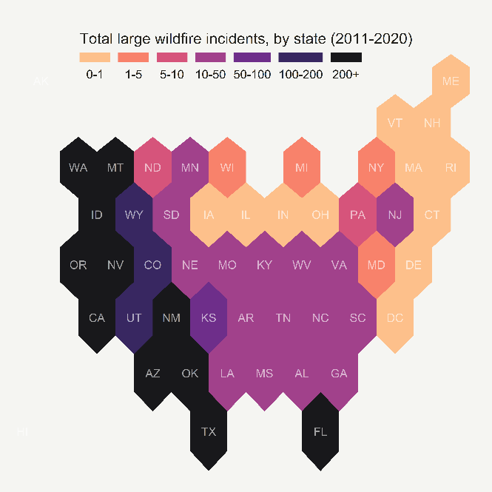

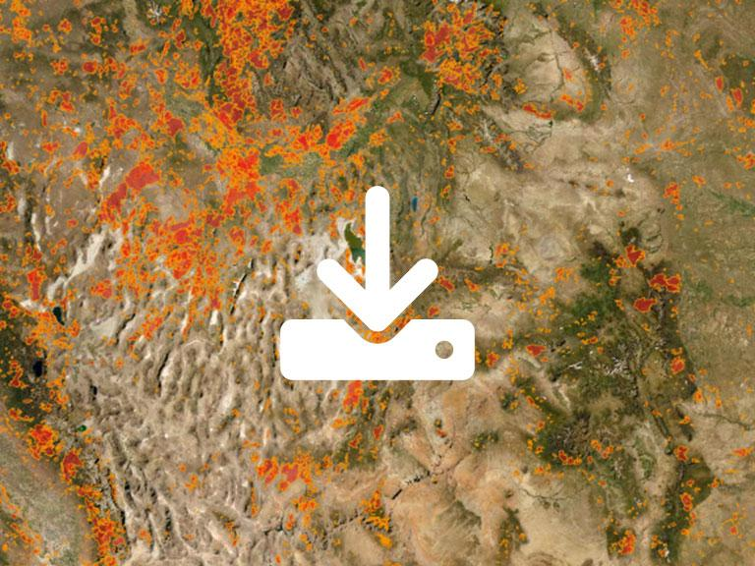
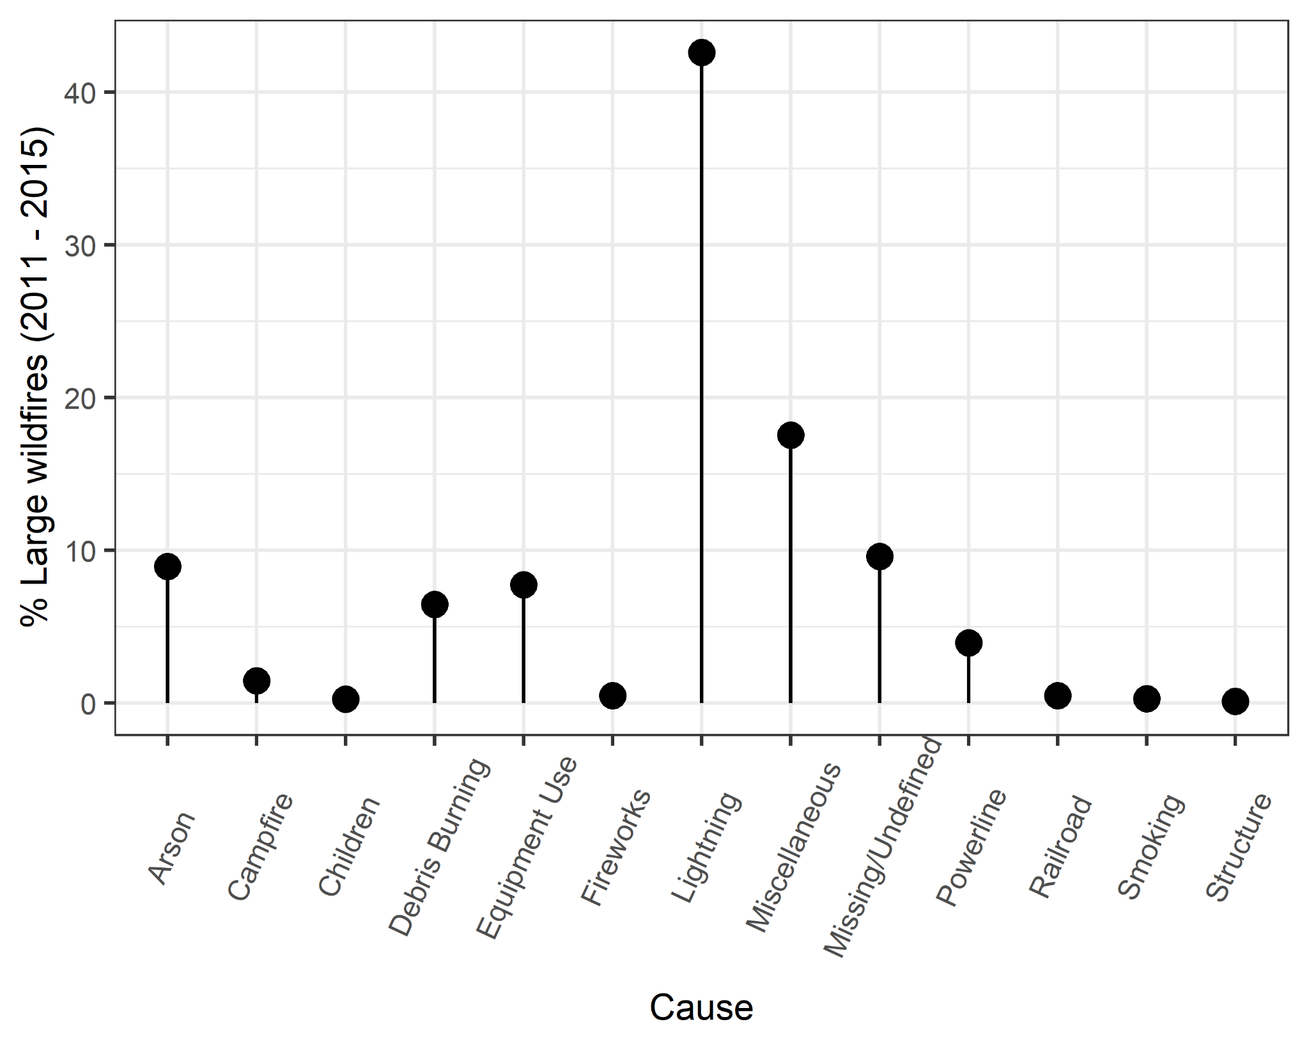


Wildfire Data
GIS data for large wildfire locations and burn area boundaries downloaded from Monitoring Trends in Burn Severity Program.
Large wildfire thresholds – 1000 acres in Western US and 500 acres in Eastern US.
10 years of data collected (2011 – 2020)
4,538 incidents covering 87,305 square miles of burn area used in analysis
Large wildfire incidents by state
Additional wildfire data obtained from Fire Program Analysis Fire-Occurrence Database (FPA-FOD) for information on wildfire causes
Major causes of large wildfires in US

Slide 4
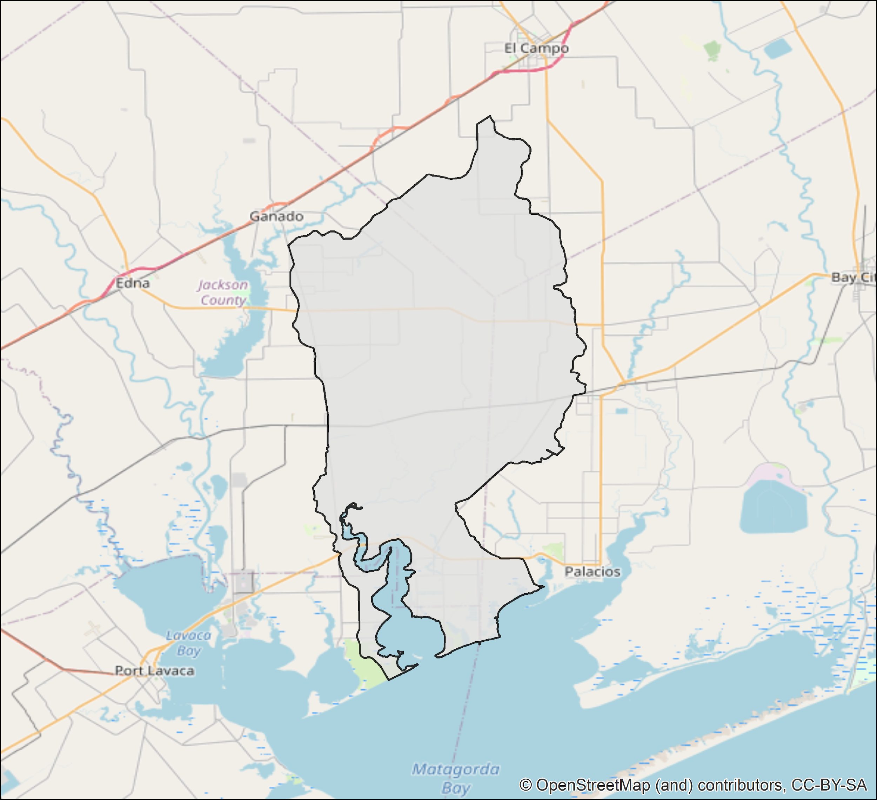
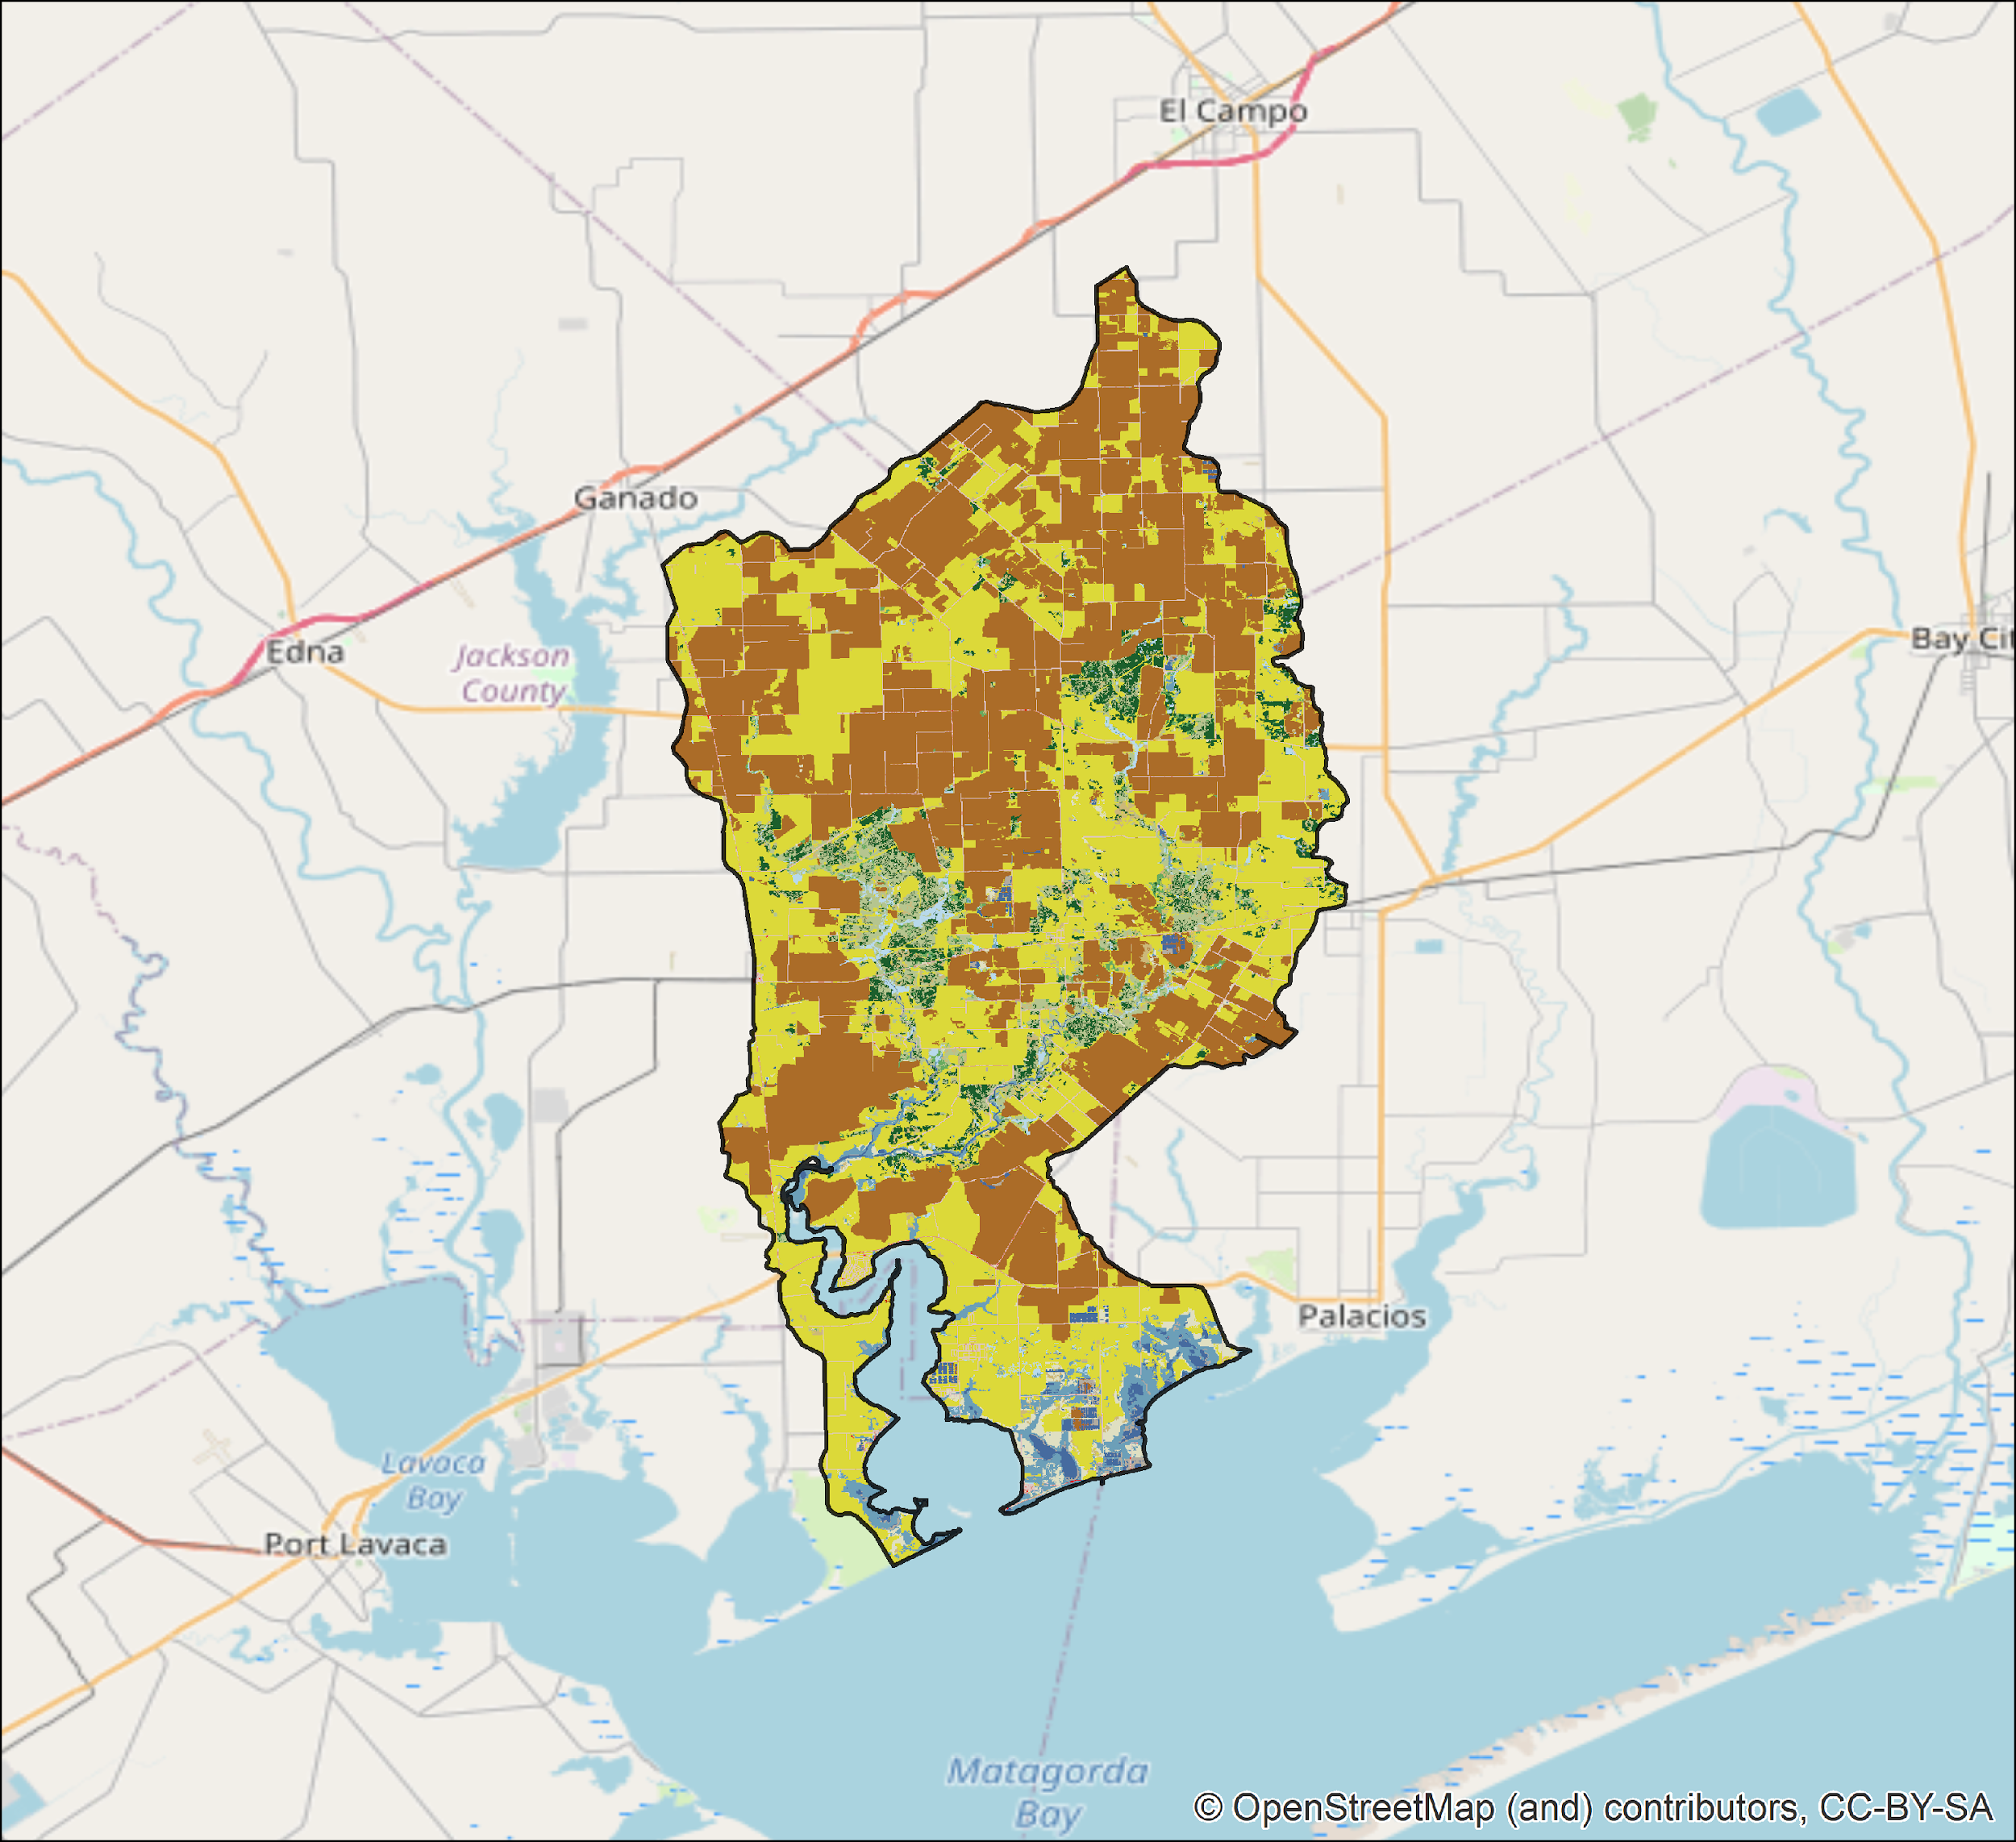
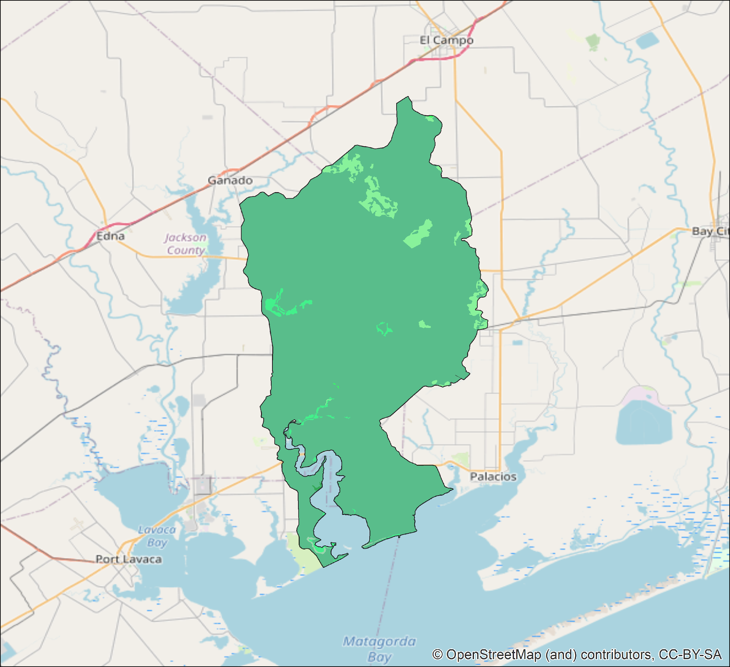
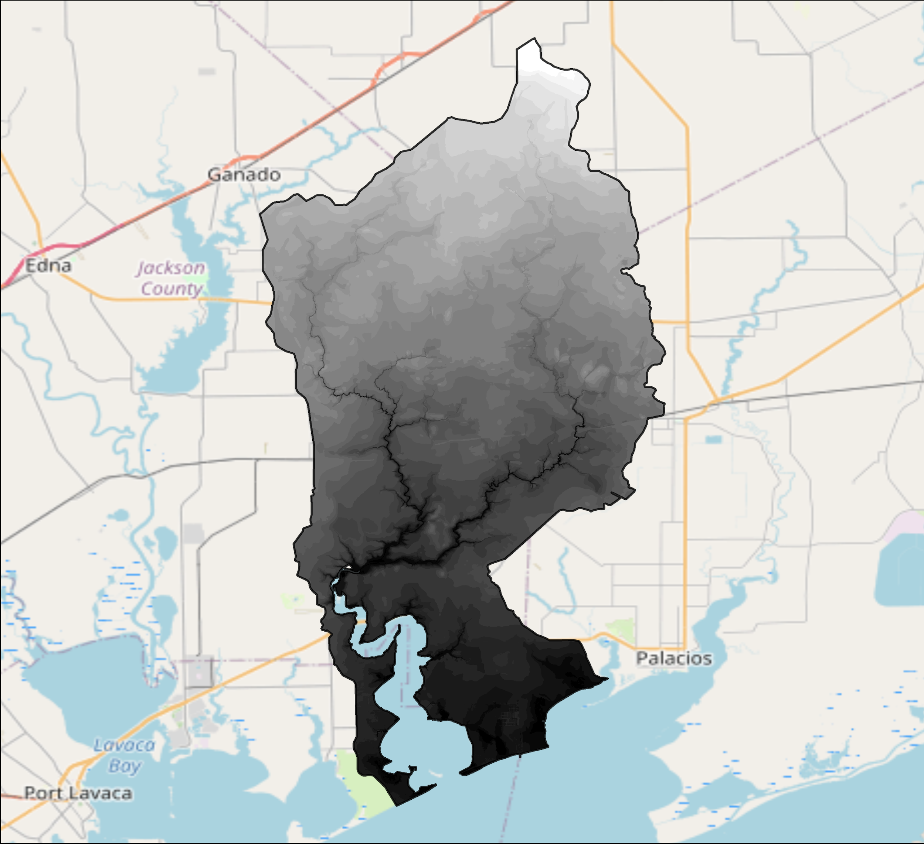
Meteorological and Topography Data
Climate
Precipitation, Temperature,
Vapor Pressure Deficit (Minimum and Maximum)
PRISM
Palmer Drought Severity Index (PDSI), Potential Evapotranspiration (PET)
GRIDMET
Land cover
Open Water, Developed, Barren, Forests, Shrub/Scrub, Hay/Pasture, Cultivated Crops, Wetlands
National Land Cover Database
(NLCD 2016)
MODIS
Normalized Difference Vegetation Index (NDVI), Enhanced Vegetation Index (EVI)
MOD13A3 Version 6
Topography
USGS DEM
Elevation (meters)
Ecoregion
Level I and Level IV ecoregion boundaries
US EPA Ecoregions

Slide 5
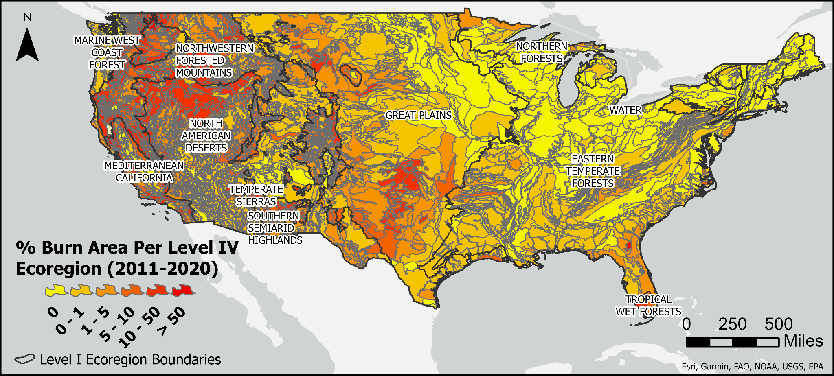
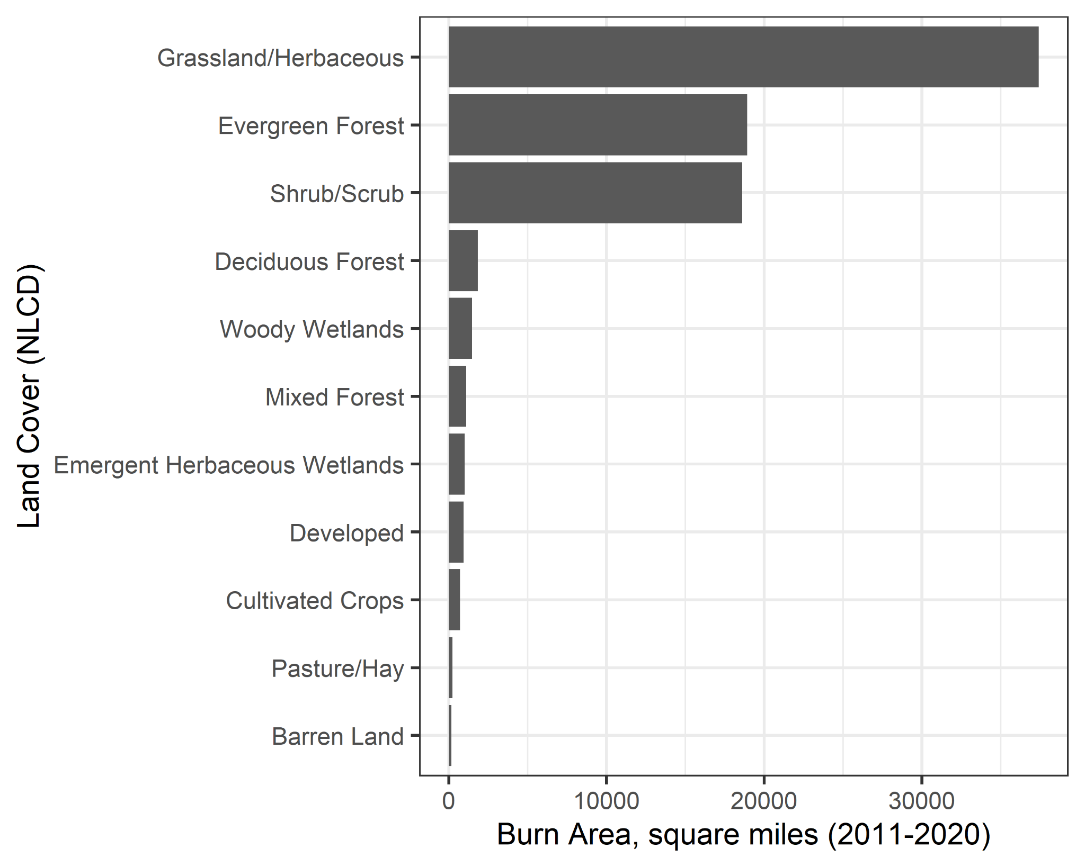
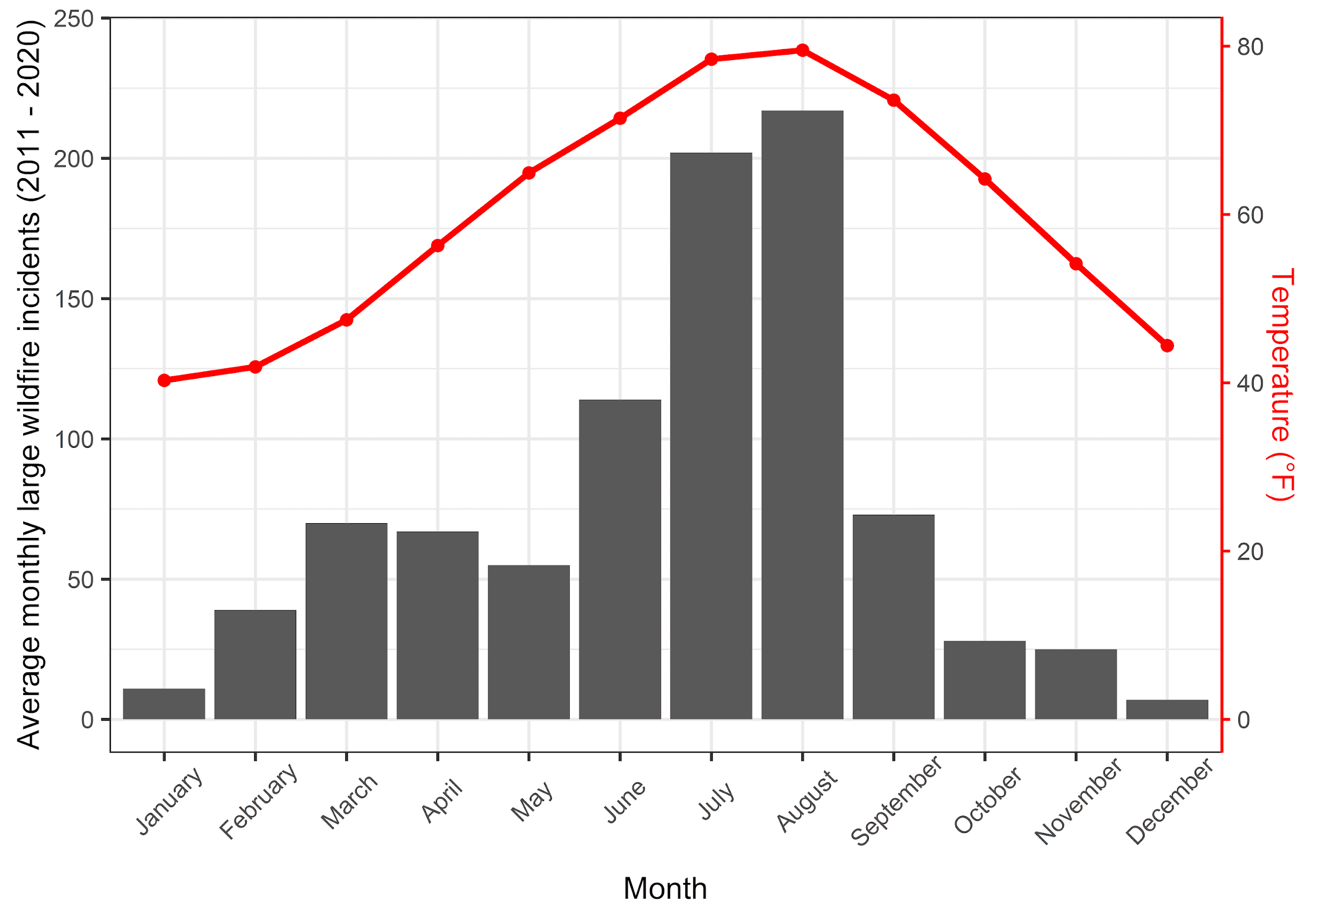
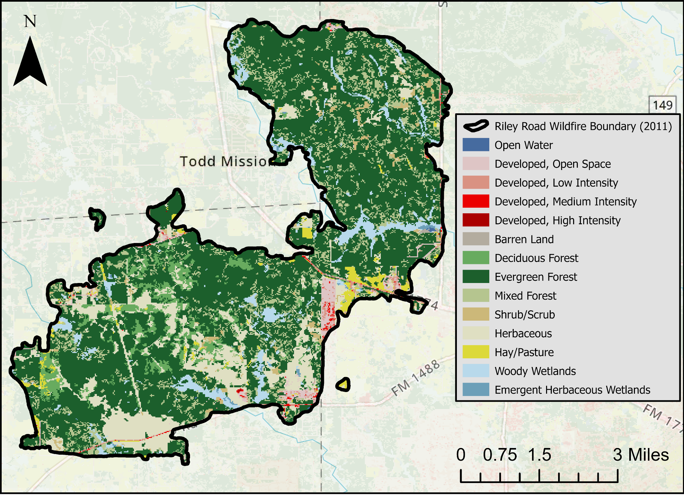
Data Exploration
Percent of Level IV Ecoregion land burned in large wildfires between 2011 - 2020
Burn area by NLCD land cover in large wildfires between 2011-2020
Average monthly large wildfires (bar) in the contiguous US and the mean monthly temperature (line).

Slide 6
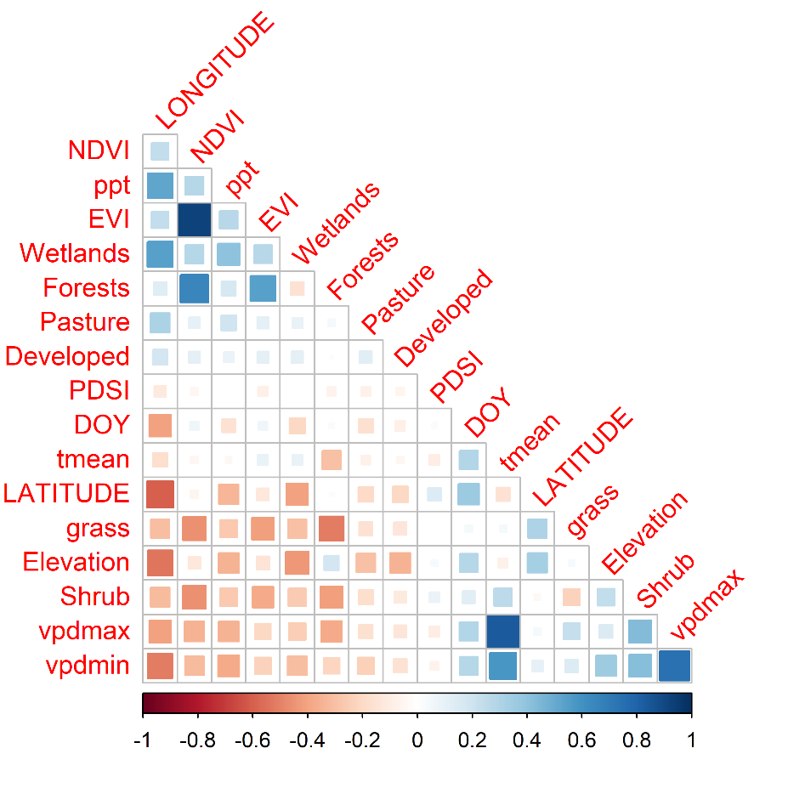
Predicting Burn Area
Features gathered for 4,536 large wildfires
Feature | Description | Min | Max
LATITUDE | Latitude coordinates of wildfire occurrence (decimal degrees) | 25.2 | 49
LONGITUDE | Longitude coordinates of wildfire occurrence (decimal degrees) | -124.1 | -72.8
DOY | Wildfire ignition day of year | 1 | 365
ppt | Total monthly precipitation for month of wildfire ignition | 0 | 1063.2
tmean | Average monthly temperature for month of wildfire ignition | -5.3 | 36.8
vpdmax | Maximum vapor pressure deficit for month of wildfire ignition | 2.7 | 81.8
vpdmin | Minimum vapor pressure deficit for month of wildfire ignition | 0 | 35.3
PDSI | Palmer Drought Severtiy Index during ignition date | -8.1 | 7.6
Developed | % NLCD developed around 4-kilometer buffer of wildfire ignition | 0 | 64.2
Forests | % NLCD forests around 4-kilometer buffer of wildfire ignition | 0 | 99.8
Shrub | % NLCD shrub/scrub around 4-kilometer buffer of wildfire ignition | 0 | 100
grass | % NLCD grasslands/herbaceous around 4-kilometer buffer of wildfire ignition | 0 | 100
Pasture | % NLCD hay/pasture around 4-kilometer buffer of wildfire ignition | 0 | 74
Wetlands | % NLCD wetlands around 4-kilometer buffer of wildfire ignition | 0 | 100
NDVI | Normalized Difference Vegetation Index for month of wildfire occurrence | 0.1 | 0.9
EVI | Enhance Vegetation Index for month of wildfire occurrence | 0 | 0.7
Elevation | Elevation of wildfire occurrence | -2 | 3507
Correlation plot for features used in the study

Slide 7
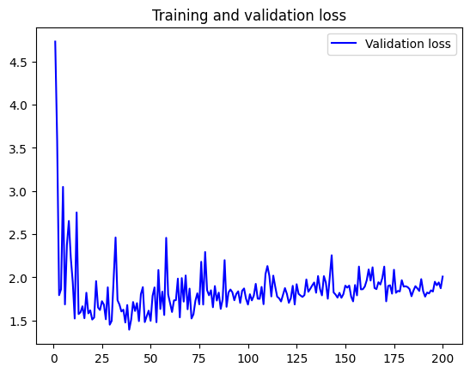
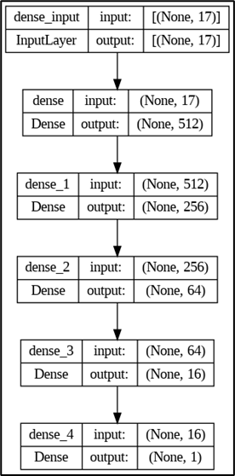
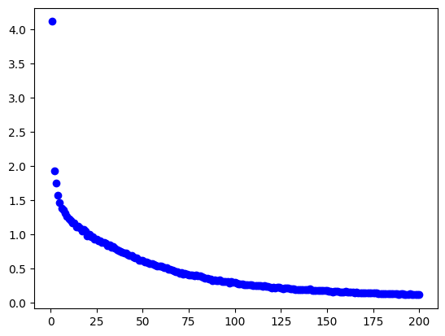
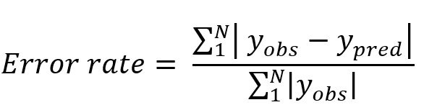
Modeling and Analysis
Validation loss for the DNN model
Model Specifications:
Train/Test split ratio - 80:20
Number of repeats: 3
Activation function: ReLU
Learning rate: 0.001
Batch size: 32
Number of Epochs: 200
Test Error (MSE): 0.055 to 0.06
Training loss for the DNN model
DNN architecture used in the study

Slide 8
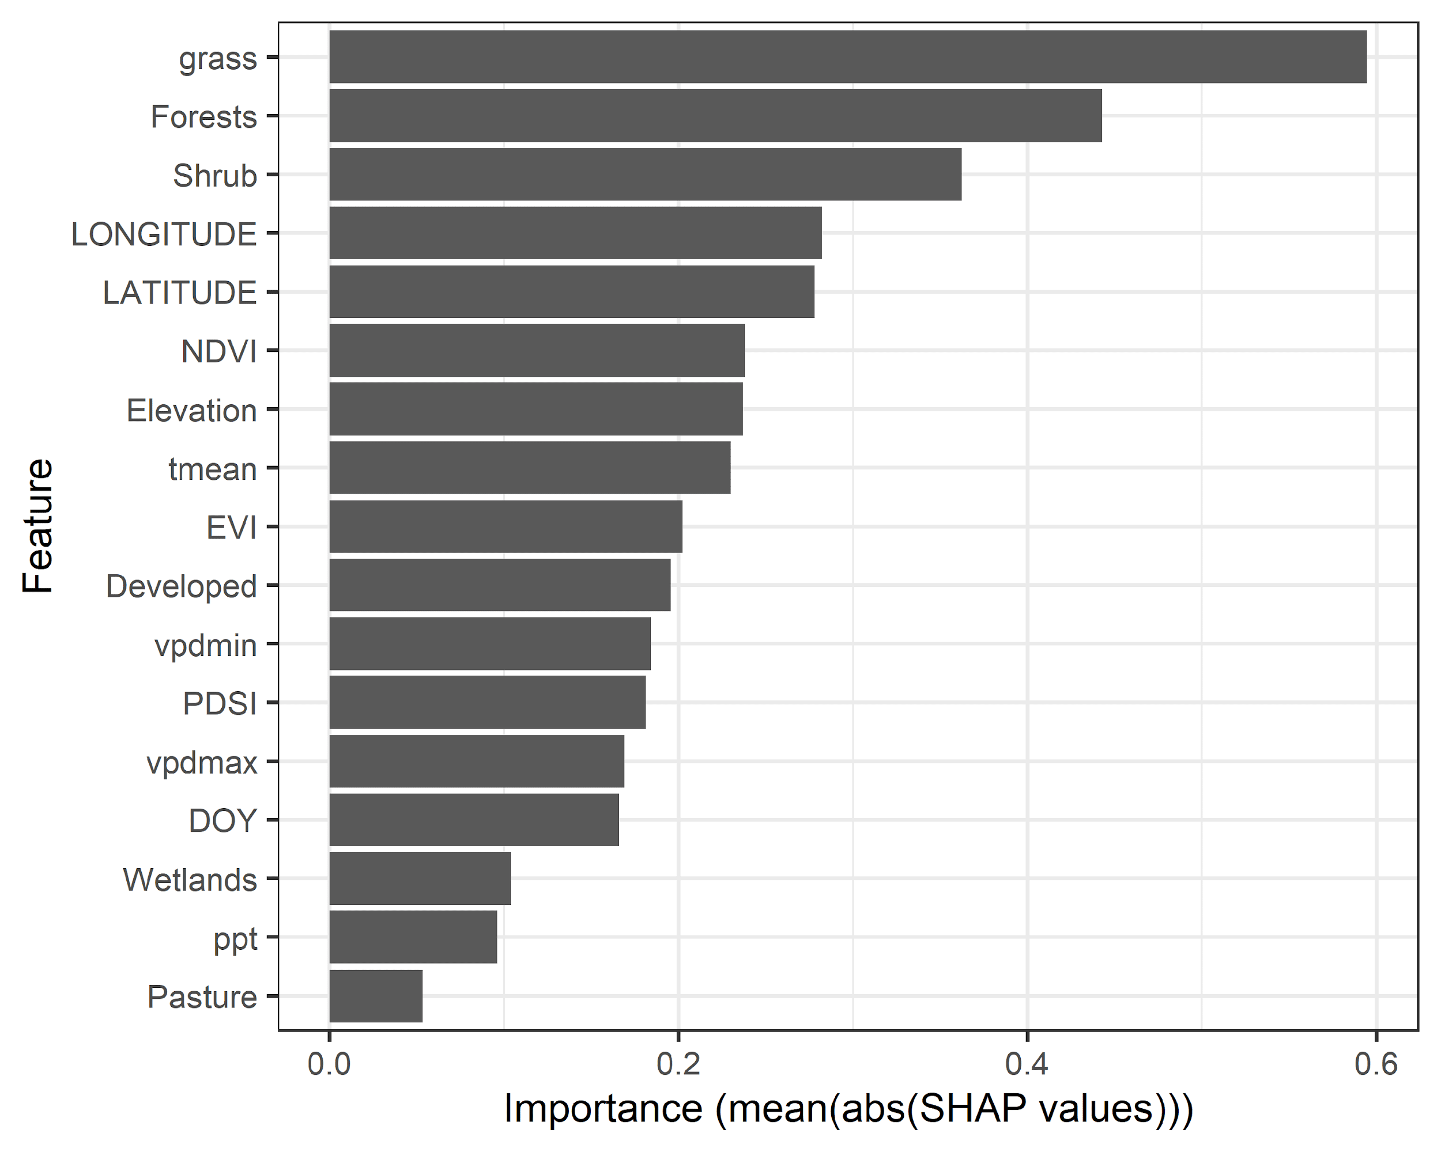
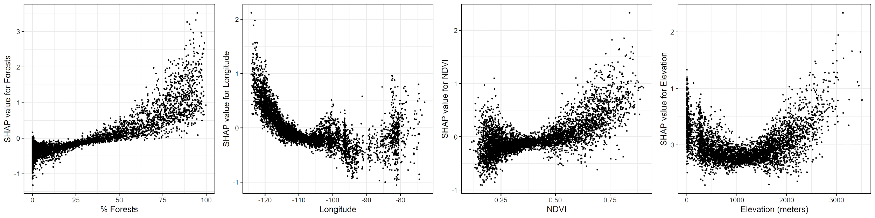
Model Inference
SHAP values are computed for each feature
Positive SHAP value indicated increase in model’s prediction due to the feature in analysis, and vice-versa
Model prediction = Average prediction + sum of all SHAP values
Feature importance in the DNN model obtained from SHAP values
Partial Dependence Plots showing the interactions between features and burn area using SHAP values

Slide 9
Conclusion
A DNN model was used to analyze the burn area of large wildfires across the contiguous United States from 2011 to 2020 with an average test MSE of 0.055
Land cover and location of wildfire occurrence found to be most influential factors in determining the severity and extent of wildfires in the United States
The predictive model can be used to forecast extent of future wildfires based on climate and land cover changes, with soil characteristics and fuel moisture being utilized to improve DNN model accuracy
Data collection, modeling and on-ground action are key areas to work on for an effective strategy to mitigate impact of forest fires
A prototype interactive web-tool was developed to visualize wildfire data for end-users
https://shubhamjain.shinyapps.io/Wildfires/

Slide 10
Recommendation and Future Work
Modeling: More features can be used to enhance prediction
Causal Inference: More analysis on how each feature affects the severity of wildfire
More interdisciplinary research by collaboration between Natural Science and Data Science
Theory-based ML: Machine learning backed by scientific theory to enhance public trust on ML models
Build more integrated open source datasets: Develop datasets including features and wildfire data for ease-of-public use and enhanced model fitting

Slide 11

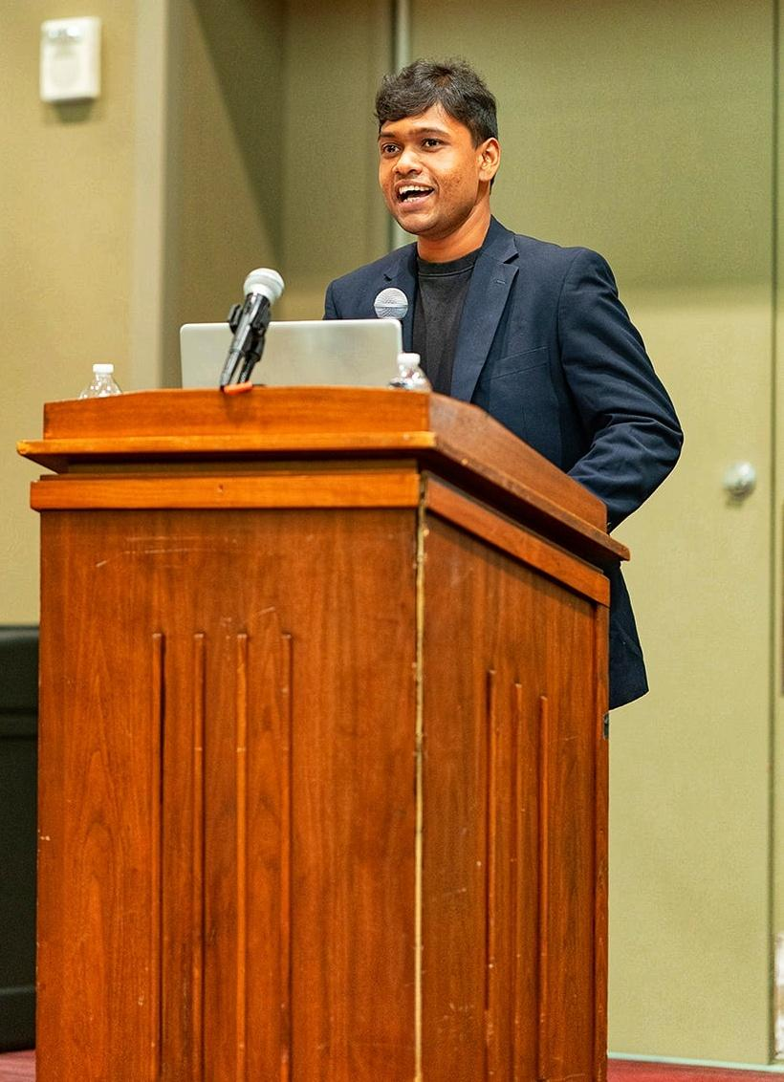


Team – Sam’s Strikers
Shubham Jain
Sambandh Bhusan Dhal
Krishna Chaitanya Gadepally
Prathik Vijaykumar
PhD Student
Water Management and Hydrological Science
PhD Candidate
Electrical and Computer Engineering
MS Student
Electrical and Computer Engineering
MS Student
Electrical and Computer Engineering

Slide 12



Hearty gratitude to our sponsors:

Slide 13
Thank You!
Questions?

